Slide 1


Maths at Cirencester Primary School
Parent Presentation

Slide 2

Mastery:
All pupils are exposed to the same quality first teaching of the same maths units together in class using small steps.
Mathematical vocabulary is developed alongside mathematical concepts.
All pupils practice key skills regularly, to embed mathematical fluency (alongside conceptual understanding).
All pupils learn to deepen their mathematical understanding of key concepts by using and applying their learned knowledge to different tasks.
All pupils are exposed to problem solving activities, using their age-related maths skills, which helps to improve computational skills and deepen their understanding further by applying their recent and prior knowledge to new mathematical questions.

Slide 3
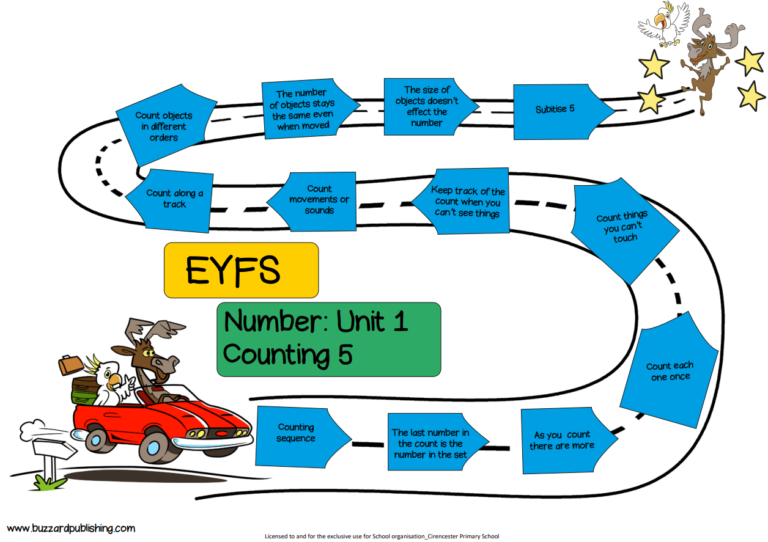
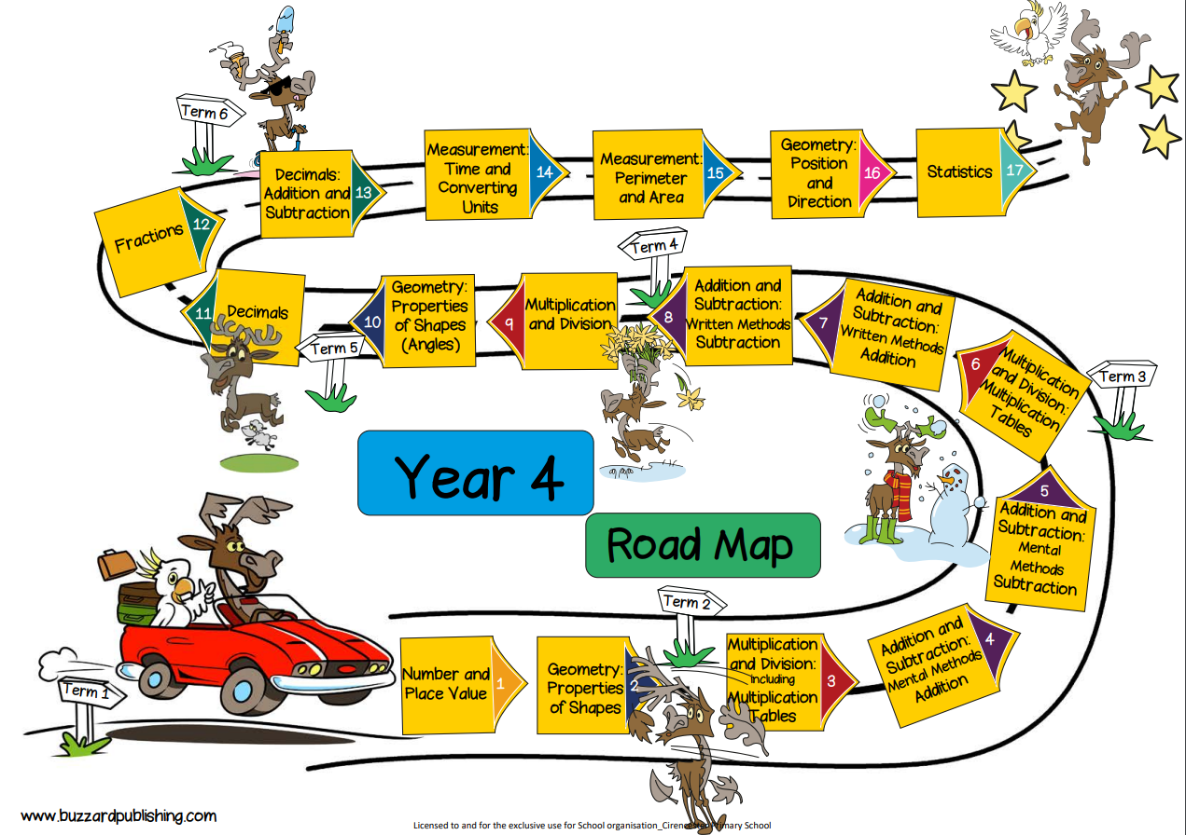
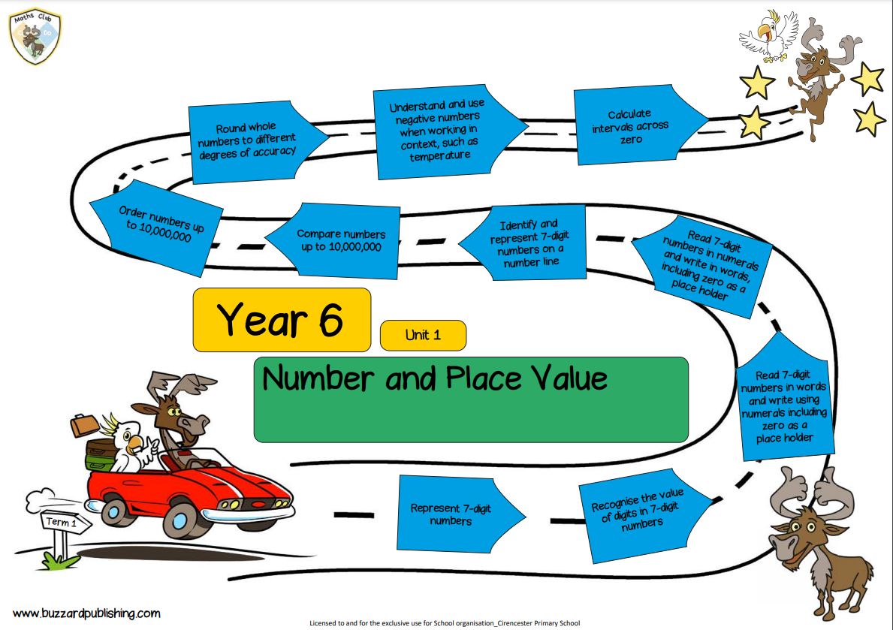
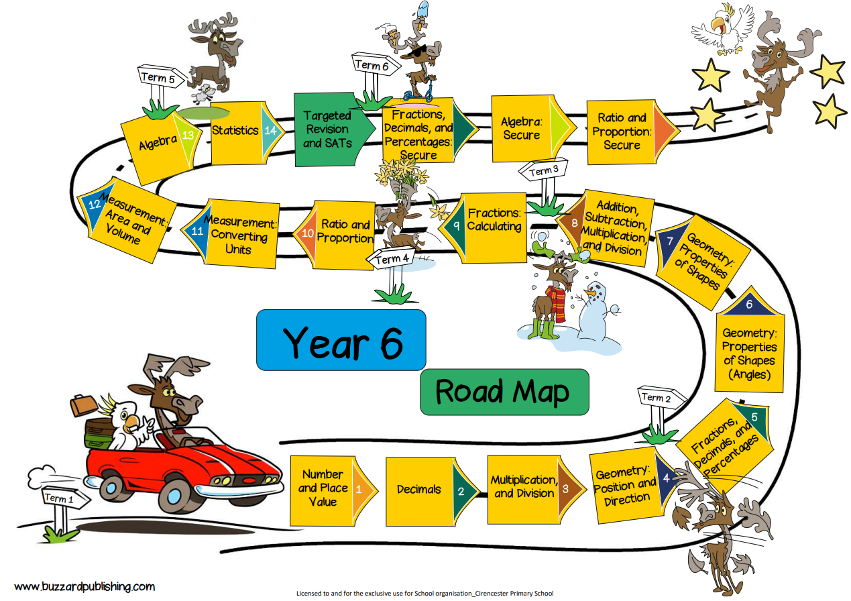
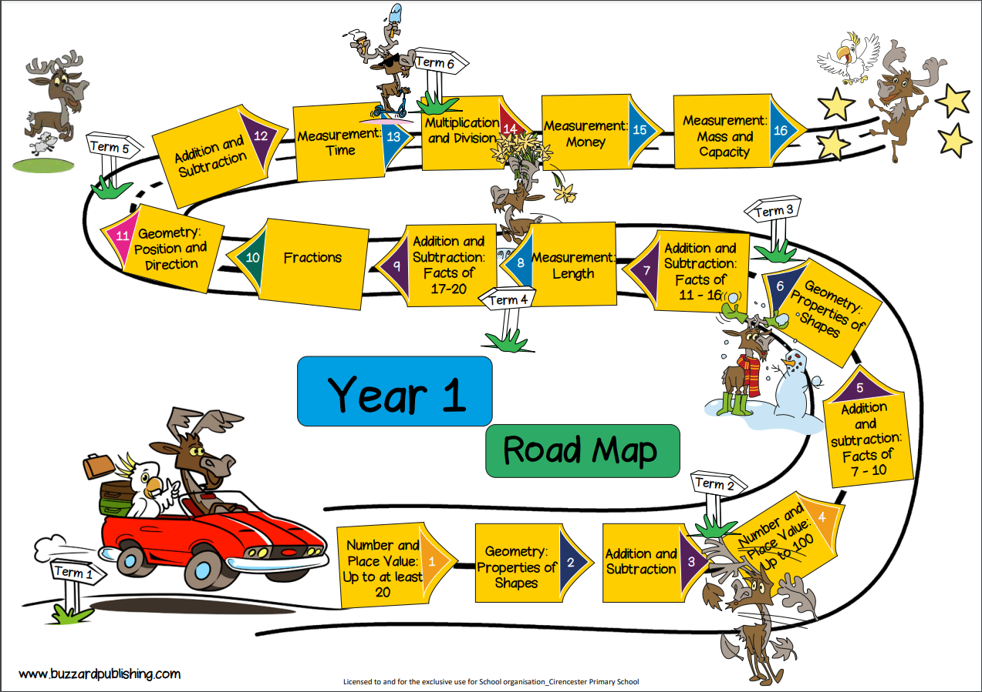
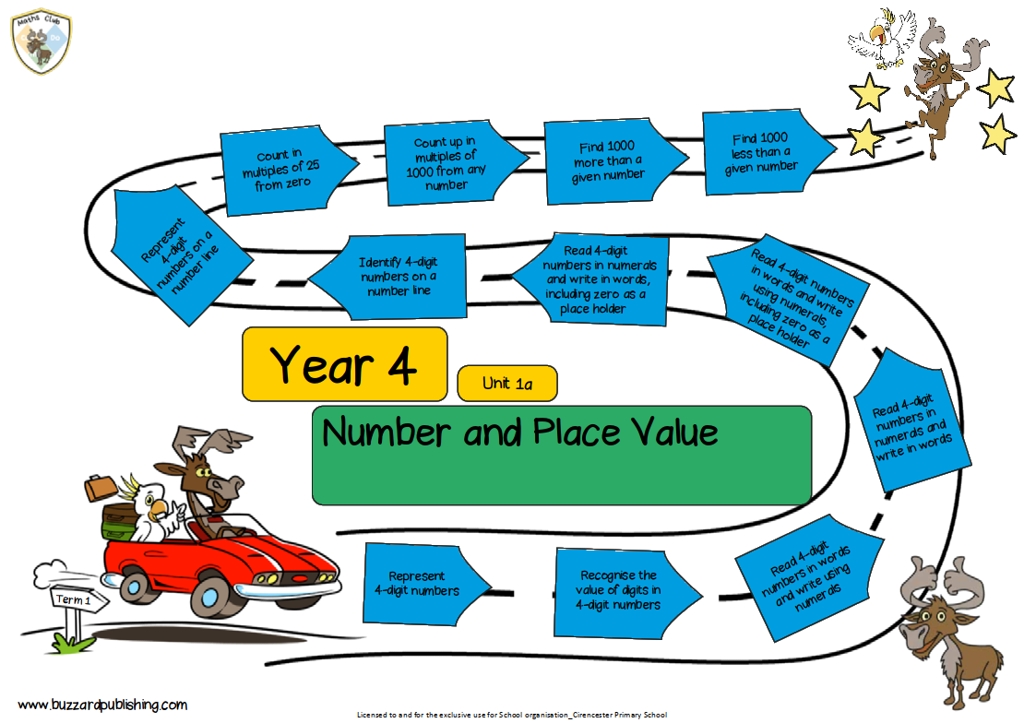
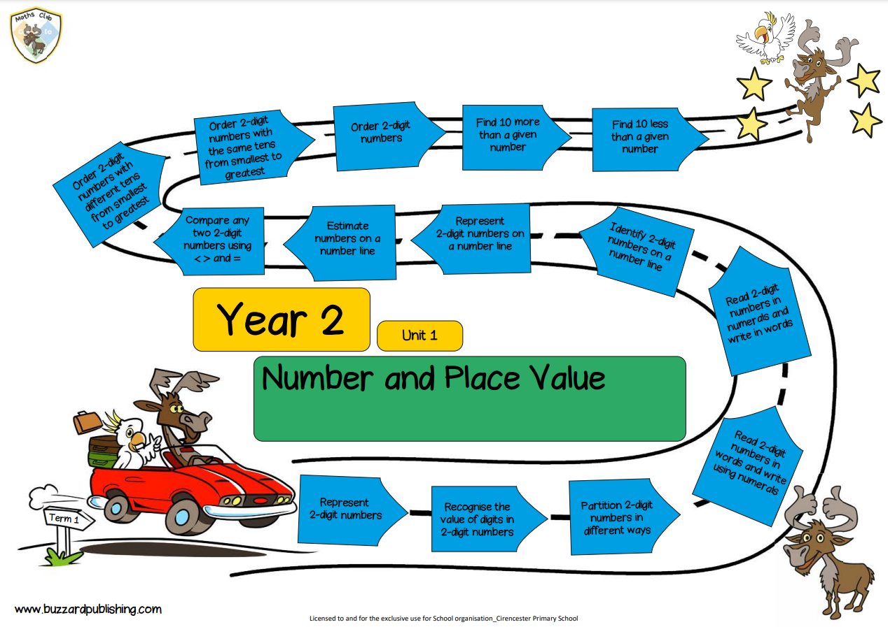

Slide 4
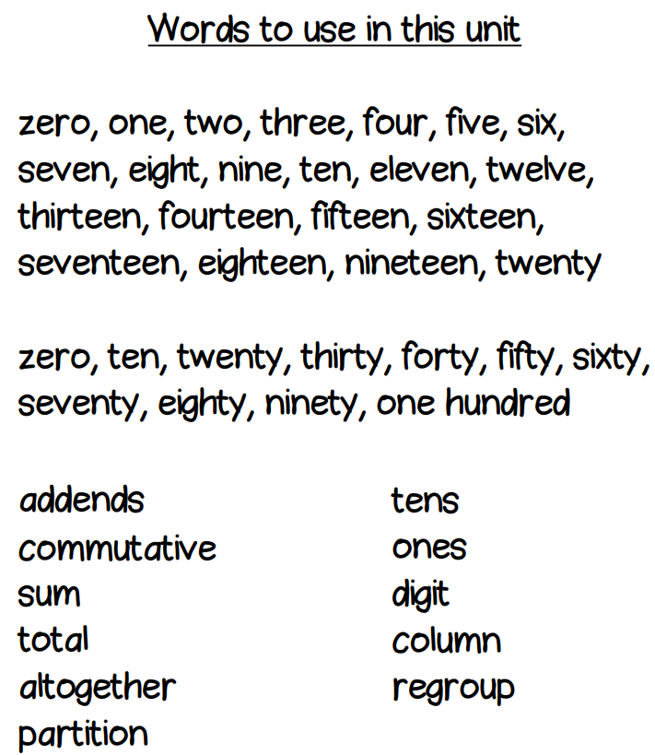
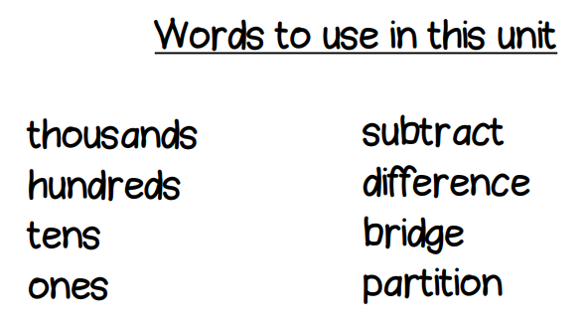
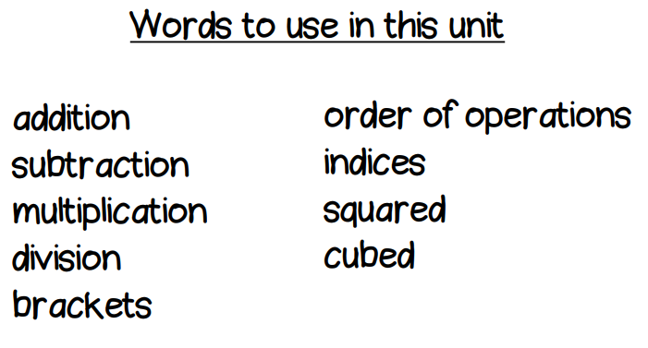
Vocabulary
Year 2
Year 4
Year 6

Slide 5
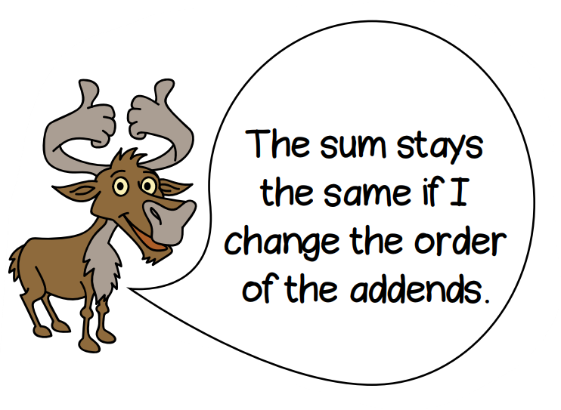
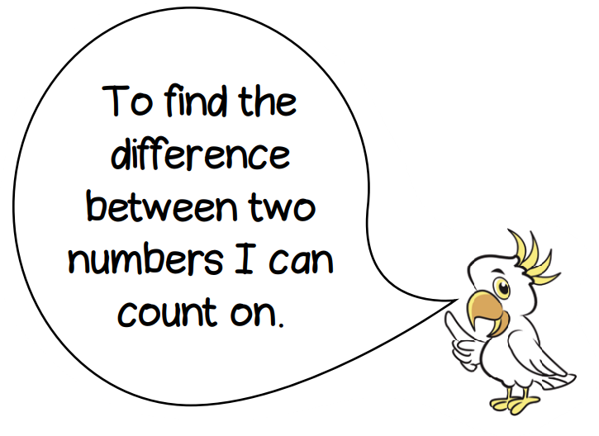
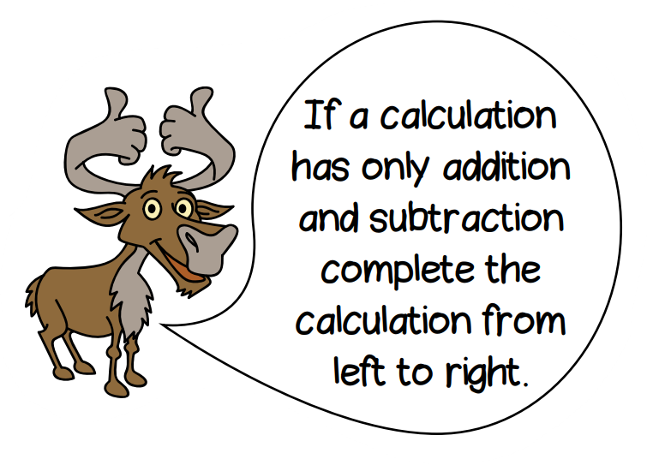
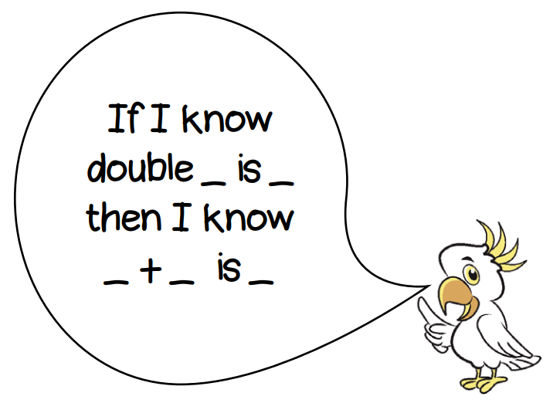
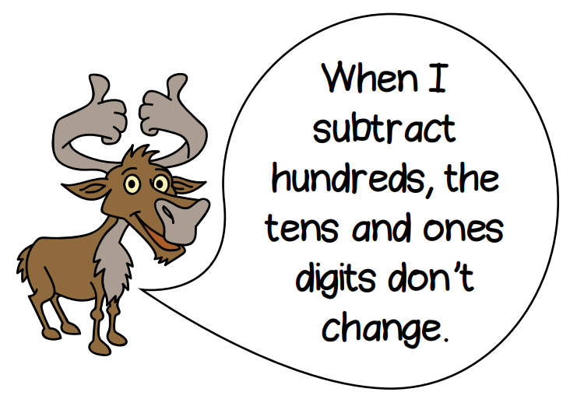
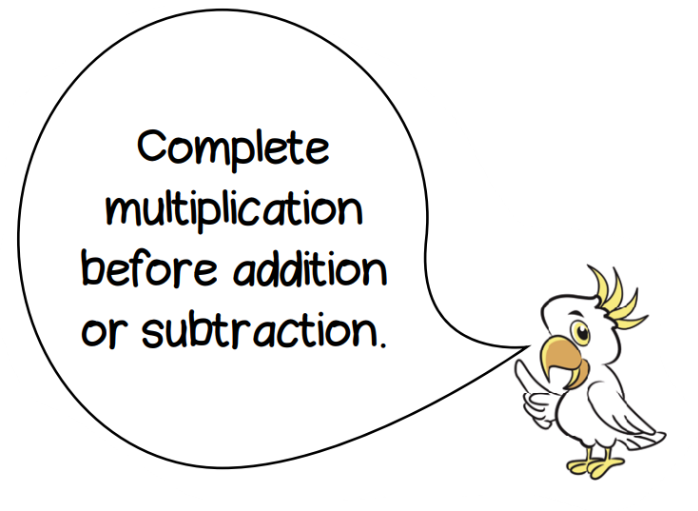
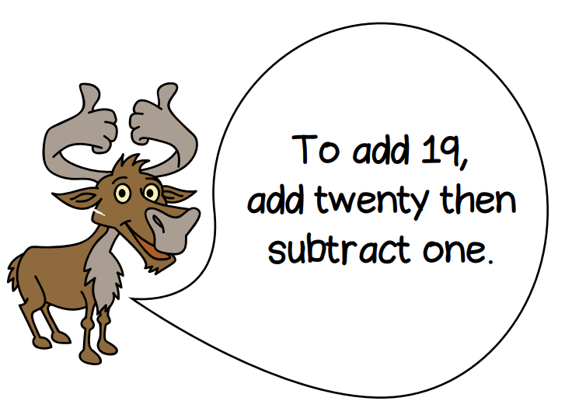
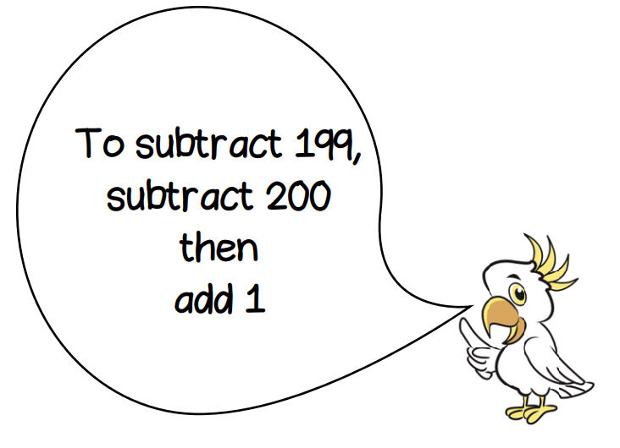
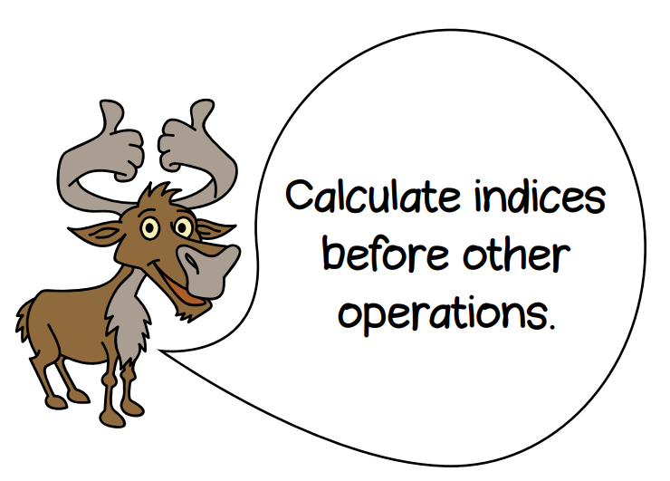
Sentence stems
Year 2
Year 4
Year 6

Slide 6
What you will see in a lesson
Lessons are 45 minutes long and split into sections
Fluency
Hook
Guided Practise
Twist it
What it is also
Deepen it
What it is not

Slide 7


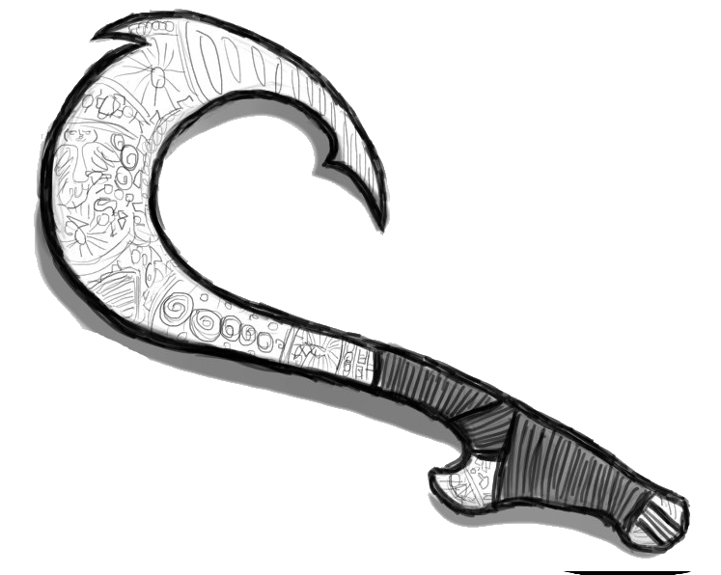
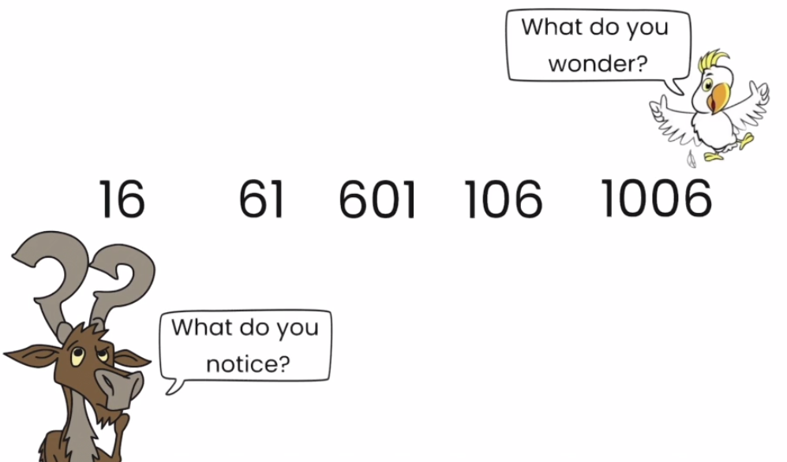
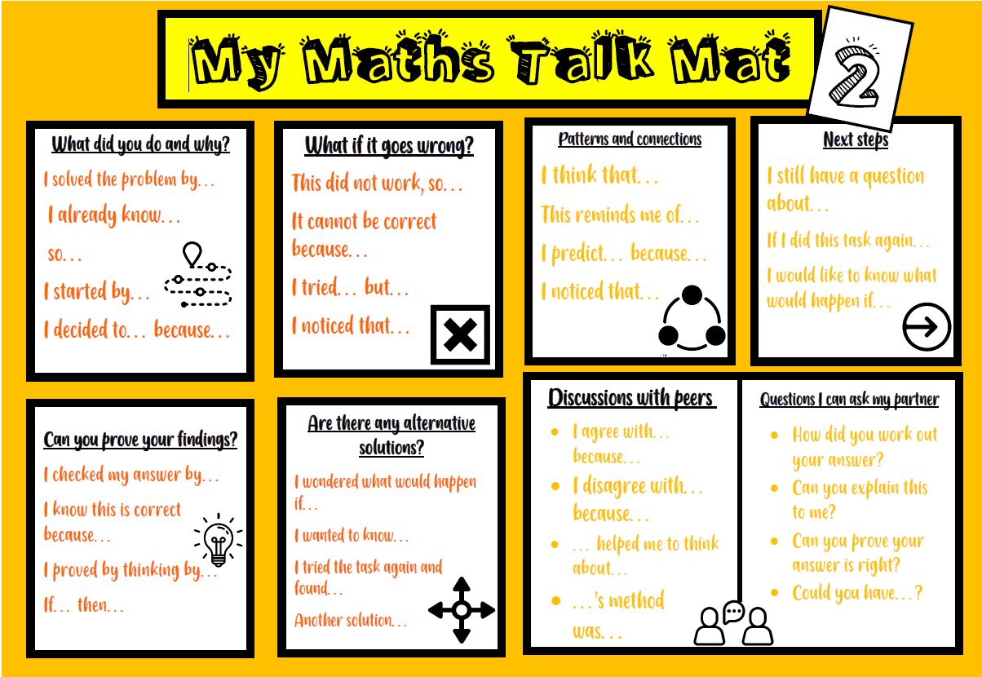
Hook

Slide 8

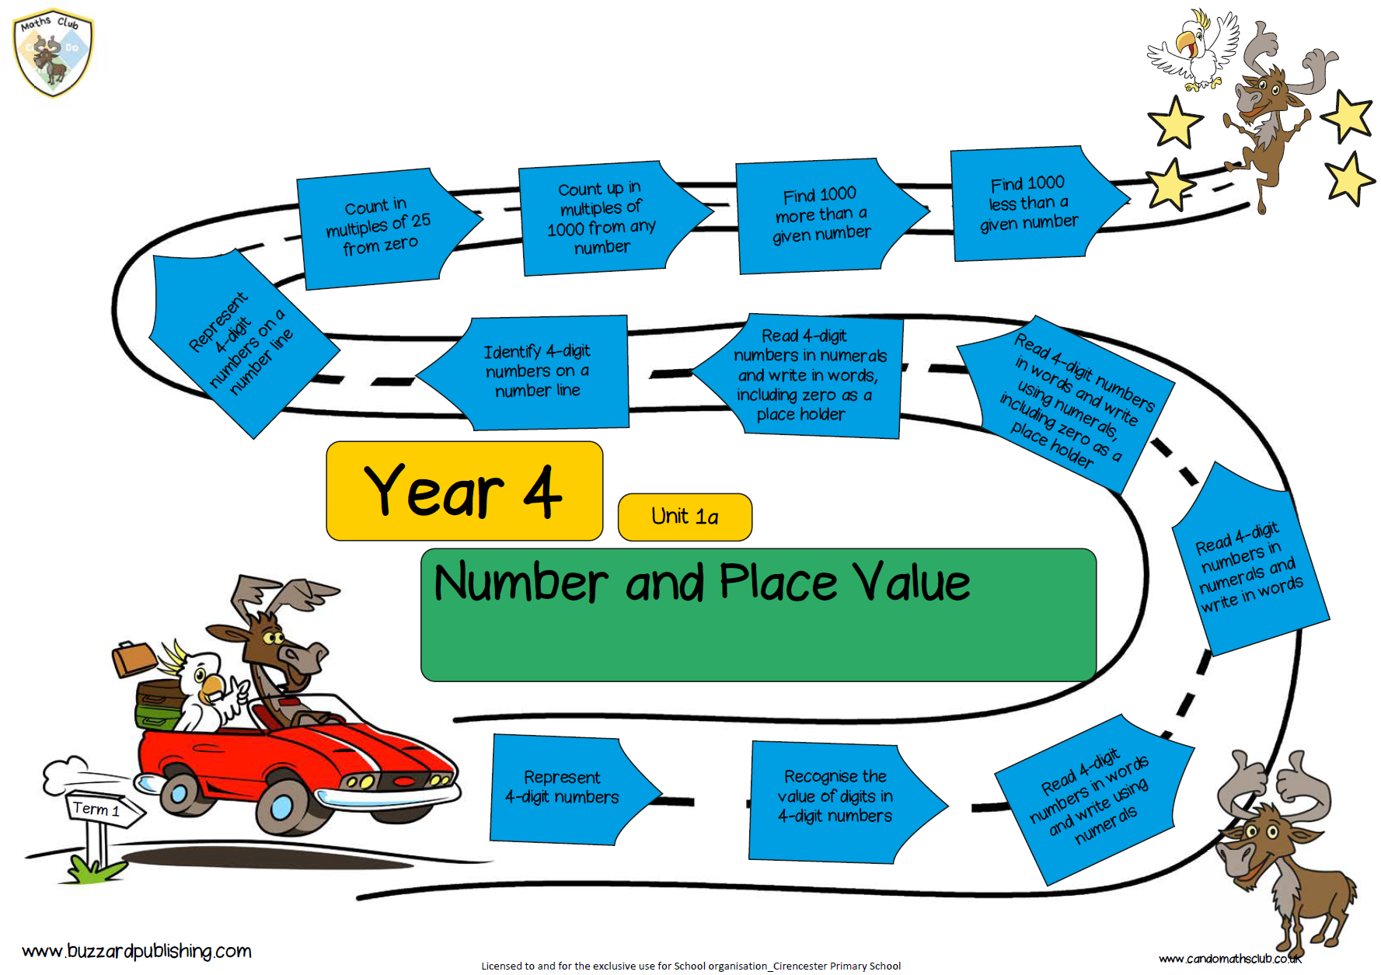

Slide 9
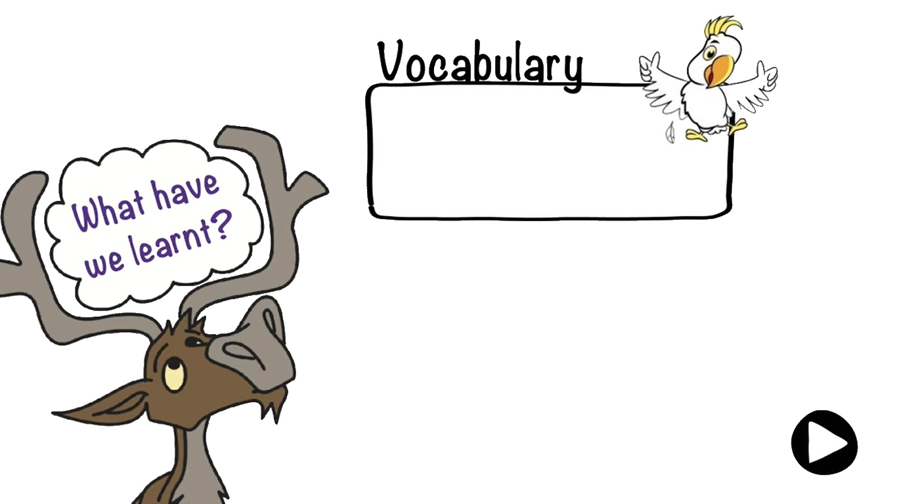
hundreds
thousands
tens
ones
digit
column
What are we learning to do?
Recognise the value of digits in 4 digit numbers

Slide 10
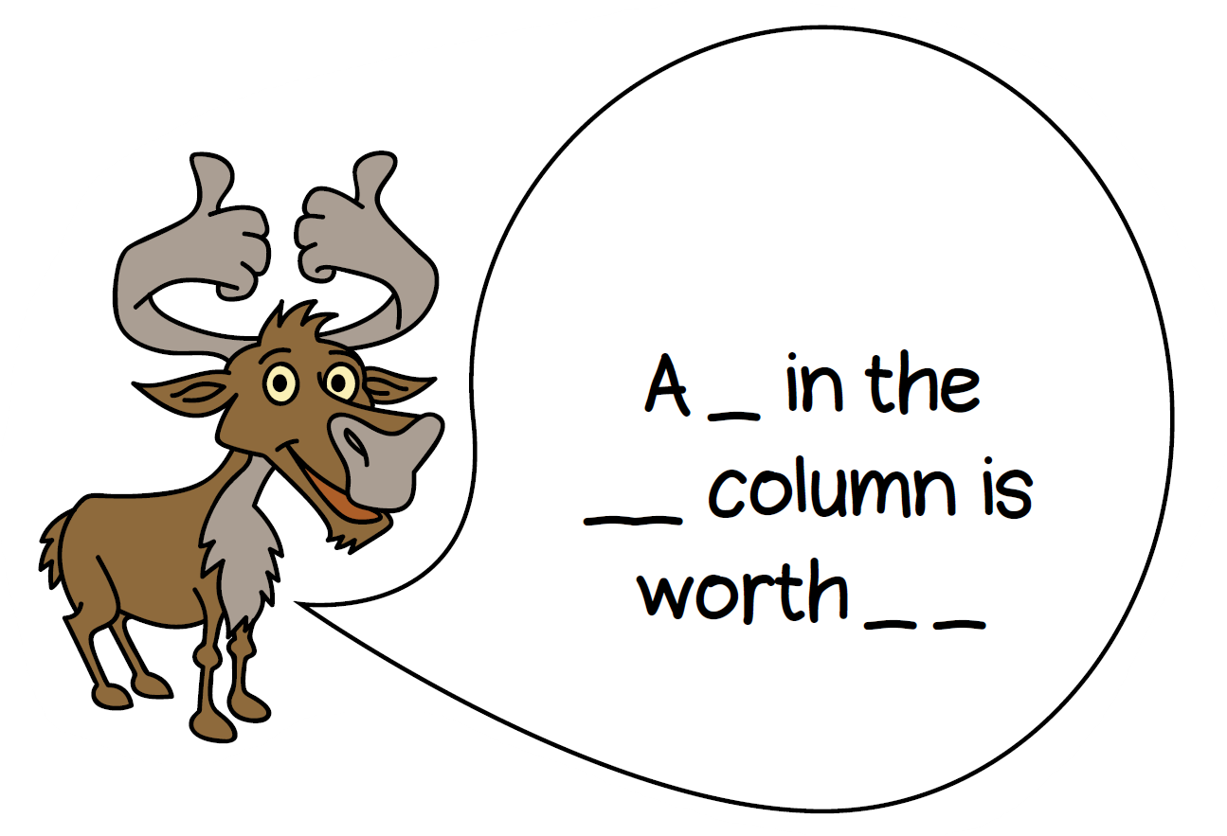




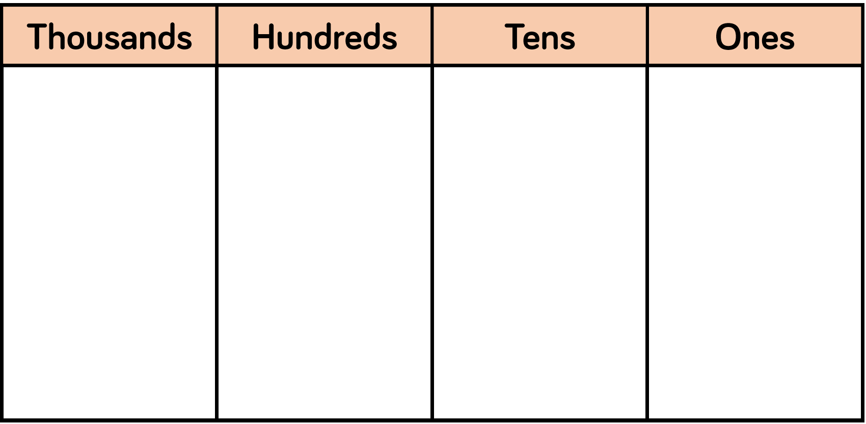
L2: recognise the value of digits in 4-digit numbers
Let’s Learn- What is it?
I do...
1
6
3
2
There are ___ thousands, ____, hundreds, ___ tens and _____ ones.
The number is _______.

Slide 11

Let’s Learn- What is it?
3
7
3
1
We do...
3
7
3
1
You do...

Slide 12
Let’s Learn- What is it?
I do...
7
0
5
1
There are ___ thousands, ____, hundreds, ___ tens and _____ ones.
The number is _______.

Slide 13
Let’s Learn- What is it?
4
0
5
1
We do...
4
0
5
1
You do...

Slide 14
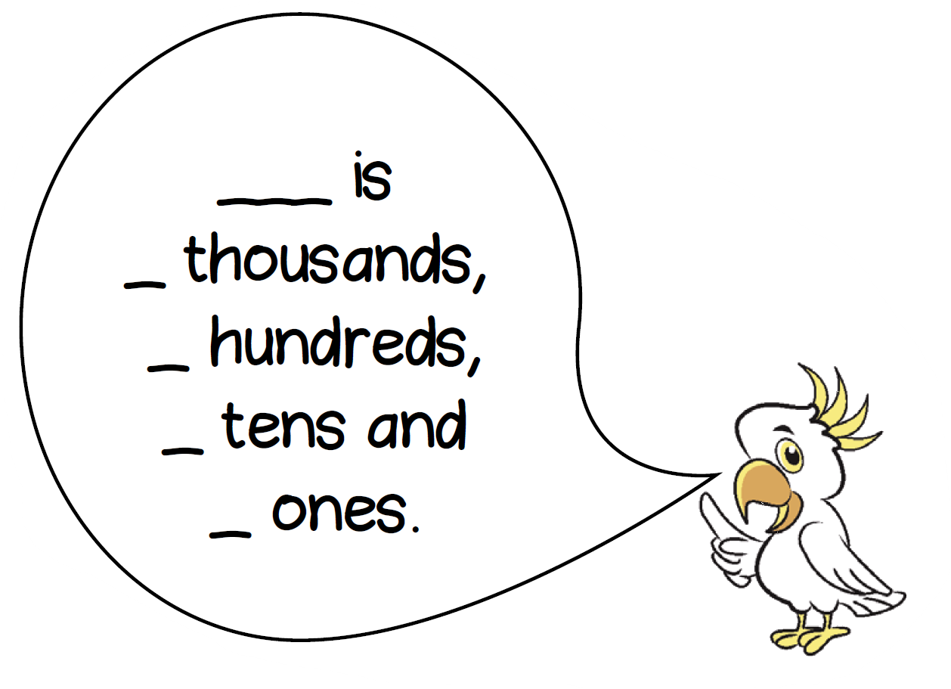
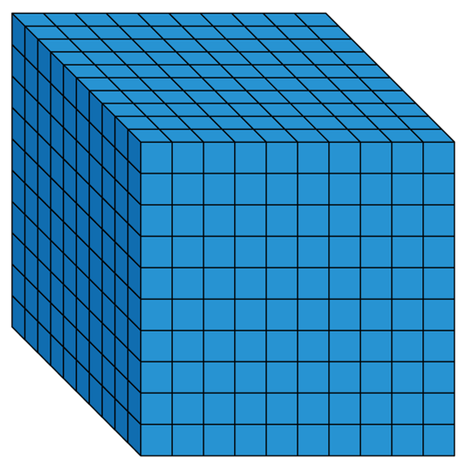
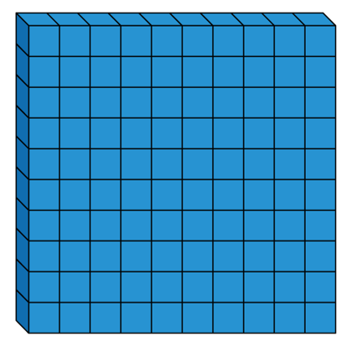

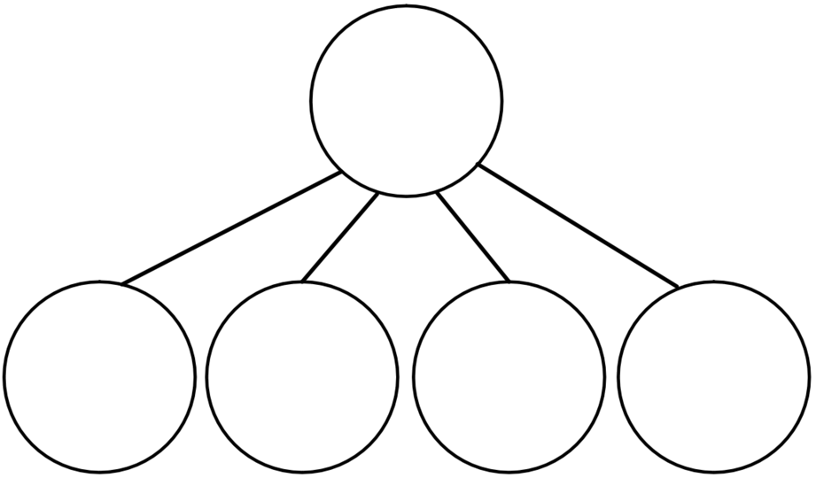

Let’s Learn- What is it also?
3215
3215 has 32 hundreds
3215 has 3215 ones

Slide 15
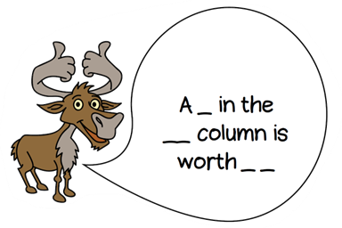
Let’s Learn- What is it not?
Colin thinks that the digit 5 in 567 is worth 5000 because it comes first.
Explain why he is incorrect
D
I know...
N
I notice...
A

Slide 16
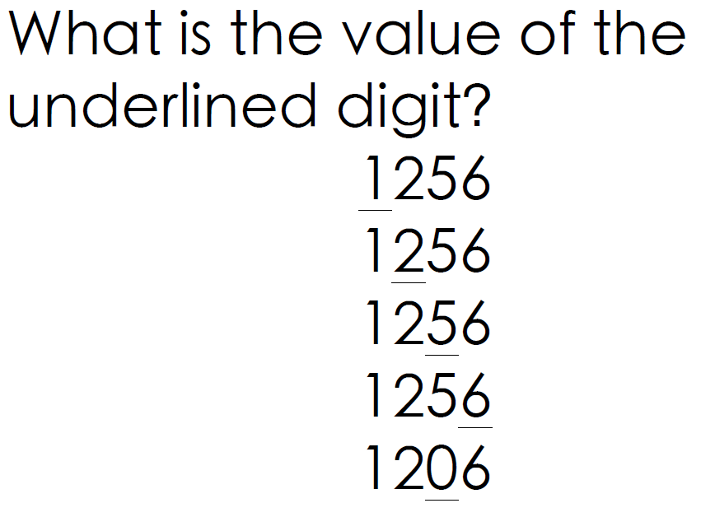
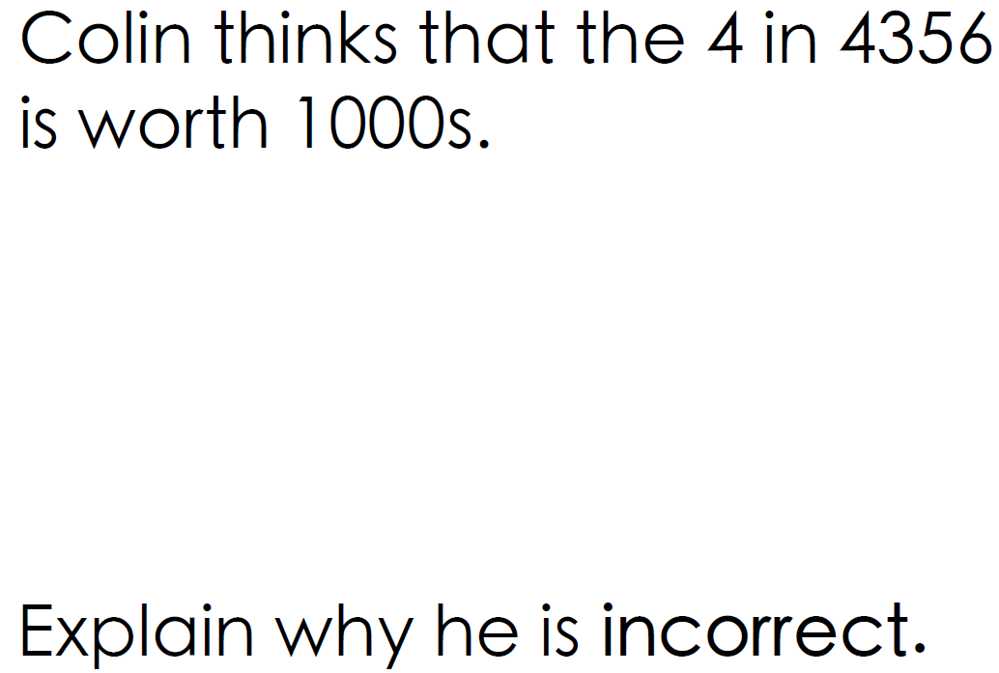
Independent Work
Fluency
Twist it

Slide 17
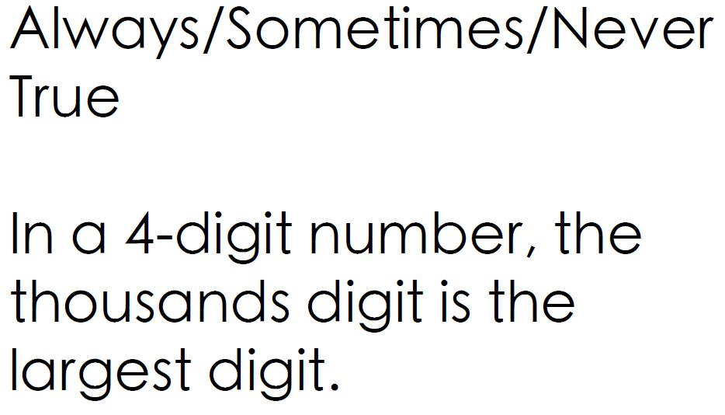
Independent Work - Answers
Deepen it

Slide 18
Review
hundreds
thousands
tens
ones
digit
column
To recognise the value of digits in 4 digit numbers

Slide 19

Self Assessment
I am really confused. I cannot do it even with resources and an adult to help me.
I can complete this work with the resources or an adult to help me.
I am confident and able to use resources and my understanding to work out the answers independently.

Slide 20
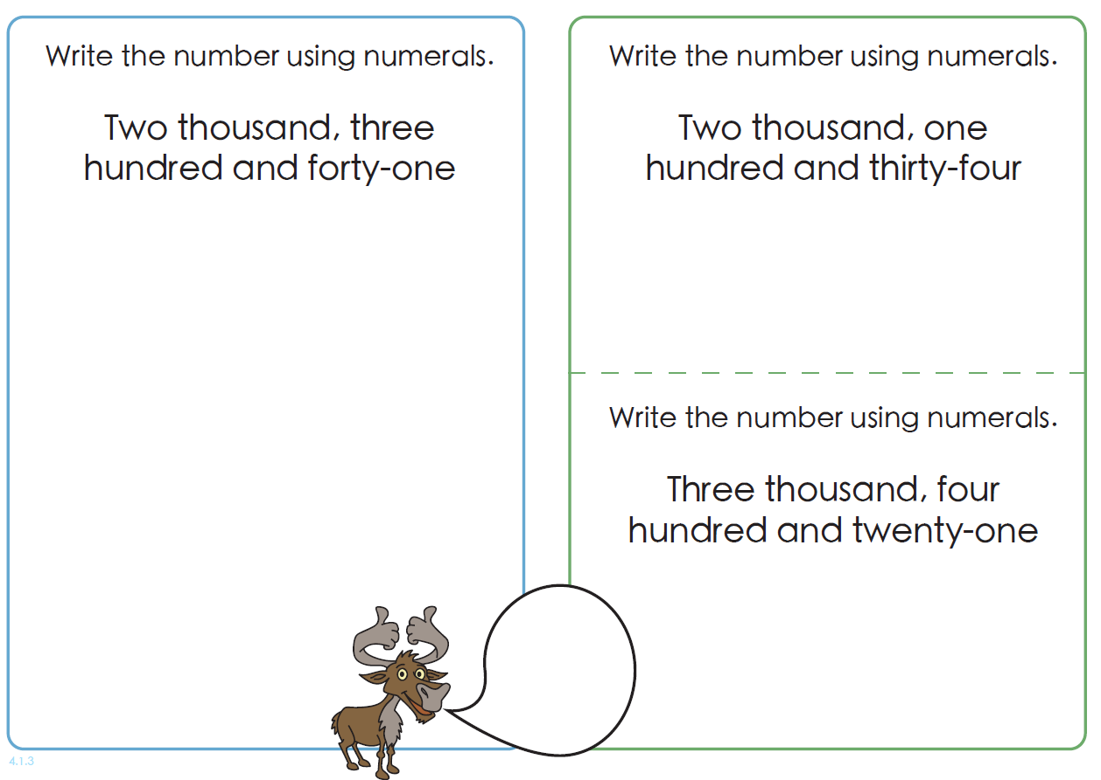
Following the lesson we have a Maths Meeting where children will work on:
Previous learning
Current learning
Problem solving
Times tables (KS2)
During this session, the teacher will work with any children who need additional support on the day’s learning
Maths Meeting
S.D.I
Create a list of 4-digit numbers. Then take it in turns to make your partner's 4-digit numbers using place value counters

Slide 21
Mastering number
Years 1 and 2 - developing a sound understanding of place value and number
Years 4 and 5 - developing their multiplicative reasoning
These are 15-20 minute daily sessions

