Slide 1


Early Reading and Phonics

Slide 2
What is Phonics?
Phonics is a way of teaching children how to read and write by hearing the different sounds that make up words in the English language.
Phonics involves matching the sounds of spoken English with individual letters or groups of letters.

Slide 3
How we teach Phonics
At Cirencester Primary School, we teach phonics using the Read Write Inc programme.
RWI Phonics aims to teach children to read accurately and fluently whilst also forming each letter correctly.
Supports the children to apply this phonic knowledge to writing words.

Slide 4
Phonics teaching starts in nursery with stories, playing with sounds and beginning to recognise individual letters, some children will also begin blending individual sounds into words.

Slide 5
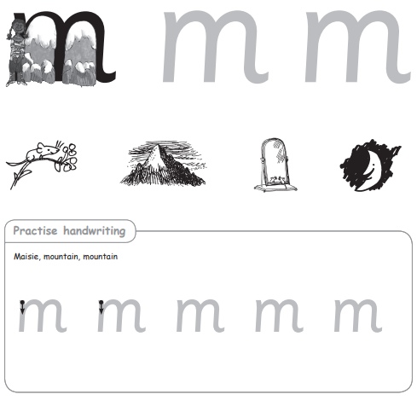
In Reception, we continue this work on individual sounds (set one).
The children learn to say, read and write the sound using a simple verbal phrase to help them.
They then begin orally blending these sounds into words.
Using these sounds to begin reading and writing words.

Slide 6
We then move onto linking these words into a phrase ‘a cat on a mat’ using photocopiable ditties.
Each session starts with a speed sounds session focusing on a set one sound :
  Hear the sound
  Recognise they letter that make the sound
  Say the sound when they see the corresponding letter
  Blend with known sounds to read words
  Write words with known sounds

Slide 7
After the speed sound session the children are introduced to their ditty
They are taught to decode the new words and build up the phrase a word at a time.
Each day is a new ditty with progressively more sounds in them.

Slide 8
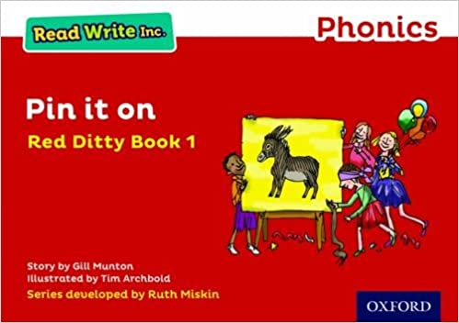
Once a child can read a phrase of words: ‘a cat on a mat’, we move on to simple sentences and introduce the story books after their set one speed sound session, starting with Red Ditties.
Each day is an individual short ditty. Each session follows the same structure:
The children are taught the green and red story words.
They practise reading the words with a partner.
The teacher introduces the story.
The children read the story with their partner.
Teacher reads to them in a story telling voice.
They play jump-in.

Slide 9
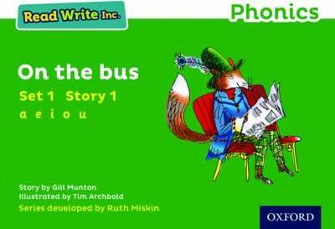
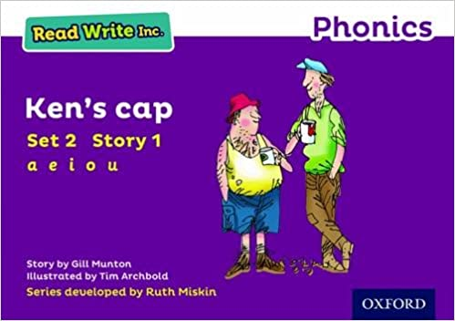
Once a child knows all their set one individual and special friend sounds and can use these to read words and phrases, they move on to Green Story books.
After a speed sound session teaching a set two sound they follow a 4 day story book programme.
Day 1 | Day 2 | Day 3 | Day 4
Speed sounds from the book | Speedy Green Words | Speedy Green Words | Think about the Story
Story Green Words | Red Words | Red Words | Third Read – Children
Speedy Green Words | Partner Practice –Green Words, Red Words, Speedy Green Words | Partner Practice –Green Words, Red Words, Speedy Green Words | Questions to Talk About
Red Word Cards
Partner Practice –Green Words, Red Words, Speedy Green Words | Story Introduction | Jump-in | Linked Text
 | First Read – Children | Second Read - Children
 | Read Aloud – Teacher

Slide 10
How do we support children who make slower progress?
Every child is assessed at the end of each half term. This helps the teachers to group the children into smaller groups at the correct level for them.
Children in each group will be working at the same level in both their individual sound knowledge and word reading.
Some children will also receive extra support in one-to-one tutoring on any specific areas that they need support in.

Slide 11
Independent reading – Phonics reading books
On a Friday, we will send home a reading for pleasure book to share together.
Once they are reading photocopiable ditties, we will send home a corresponding phonics reading book to the story book taught in school on a Monday. These need to be returned to school on a Friday.

Slide 12

How can parents help at home?
Encouraging your child to read and retell story books.
Encouraging your child to say the letter sounds correctly.
Encouraging your child to form the letter correctly for writing.
Ensure your child reads their phonics reading book at least 3 times a week.

Slide 13
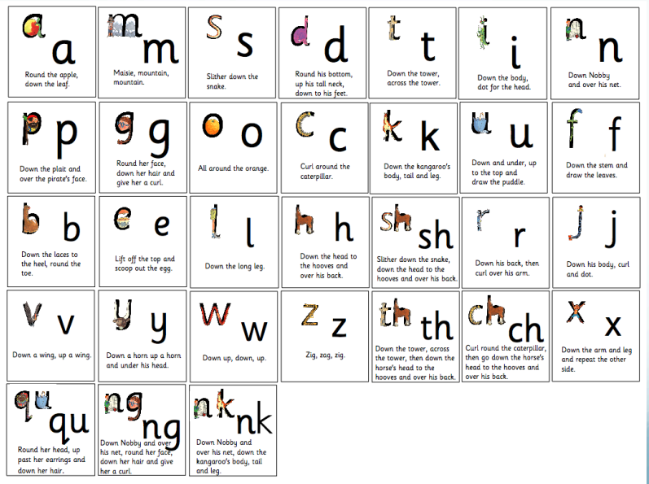
Set one sounds

Slide 14
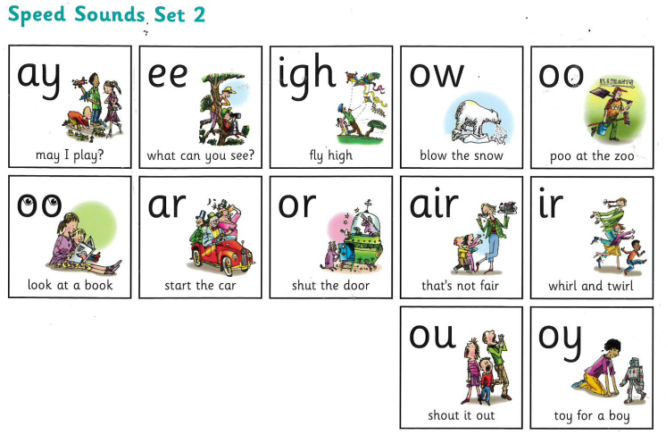
Set two sounds

Slide 15
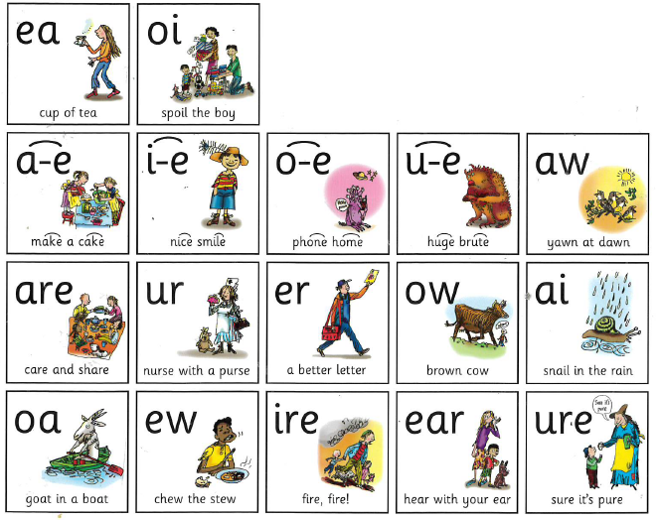
Set three sounds

