Slide 1


Early Reading and Phonics

Slide 2
What is Phonics?
Phonics is a way of teaching children how to read and write by hearing the different sounds that make up words in the English language.
Phonics involves matching the sounds of spoken English with individual letters or groups of letters.

Slide 3
How we teach Phonics
At Cirencester Primary School, we teach phonics using the Read Write Inc programme.
RWI Phonics aims to teach children to read accurately and fluently whilst also forming each letter correctly.
Supports the children to apply this phonic knowledge to writing words.

Slide 4
At the end of each academic year, the children will complete a final assessment to see where they need to start in September.
Most children at the start of Year 1 will be on Green or Purple story books and learning set two sounds.
Most children at the start of Year 2 will be on Yellow or Blue story books and learning set three sounds.
Children begin learning set two sounds with Green books and set three with Orange books.

Slide 5
Each session starts with a speed sounds session focusing on new sound:
  Hear the sound
  Recognise the pair or group of letters that make the sound
  Say the sound when they see the corresponding letter
  Read words with new sound and already known sounds by:
    Spot the special friend
    Fred talk
    Read the word
  Read the words again with fred in the head
  Read words speedily
  (by sight)
  Write the words using fred fingers

Slide 6
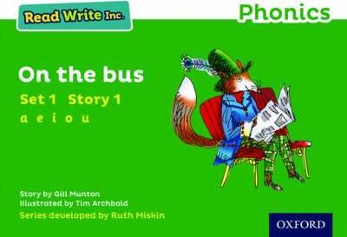
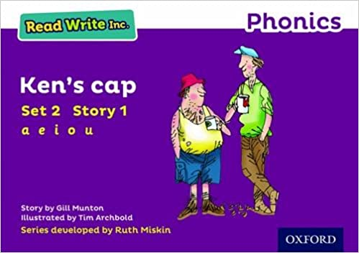

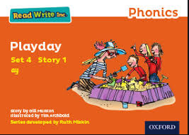
After a speed sound session, they follow a 4 day story book programme.
Day 1 | Day 2 | Day 3 | Day 4
Speed sounds from the book | Speedy Green Words | Speedy Green Words | Think about the Story
Story Green Words | Red Words | Red Words | Third Read – Children
Speedy Green Words | Partner Practice –Green Words, Red Words, Speedy Green Words | Partner Practice –Green Words, Red Words, Speedy Green Words | Questions to Talk About
Red Word Cards
Partner Practice –Green Words, Red Words, Speedy Green Words | Story Introduction | Jump-in | Linked Text
 | First Read – Children | Second Read - Children
 | Read Aloud – Teacher

Slide 7
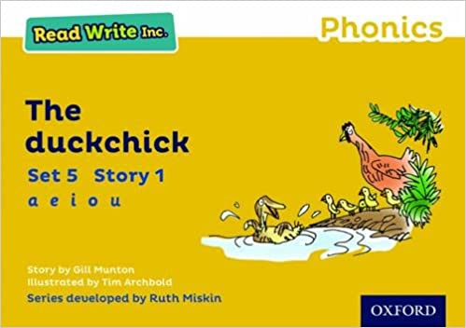
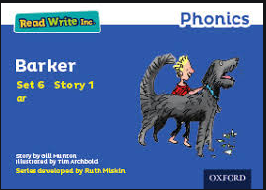
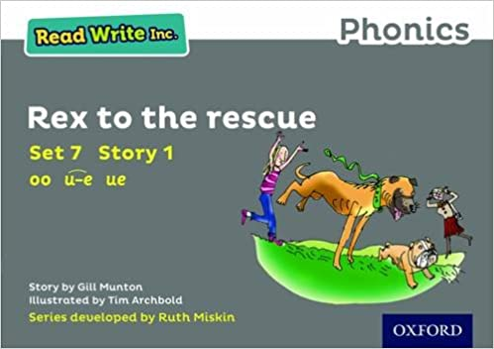
After a speed sound session, they follow a 4 day story book programme.
Day 1 | Day 2 | Day 3 | Day 4
Speed sounds from the book | Speedy Green Words | Speedy Green Words | Think about the Story
Story Green Words | Red Words | Red Words | Third Read – Children
Speedy Green Words | Partner Practice –Green Words, Red Words, Speedy Green Words | Partner Practice –Green Words, Red Words, Speedy Green Words | Questions to Talk About
Red Word Cards
Partner Practice –Green Words, Red Words, Speedy Green Words | Story Introduction | Jump-in | Questions to Read and Answer
 | First Read – Children | Second Read - Children
 | Read Aloud – Teacher
Red Rhythm Spellings | Fred-Fingers – Spelling Green Words | Red Rhythm Spellings | Linked Text

Slide 8
How do we support children who make slower progress?
Every child is assessed at the end of each half term. This helps the teachers to group the children into smaller groups at the correct level for them.
Children in each group will be working at the same level in both their individual sound knowledge and word reading.
Some children will also receive extra support in one-to-one tutoring on any specific areas that they need support in.

Slide 9
Independent reading – Phonics reading books
On a Friday, we will send home a homework sheet for the book taught the following week and a reading for pleasure book to share together.
On the following Monday, we will send home the corresponding phonics reading book to the story book taught in school. The red and green words will be the same in both their in school story book and home phonics reading book. This needs to be returned on Friday.

Slide 10
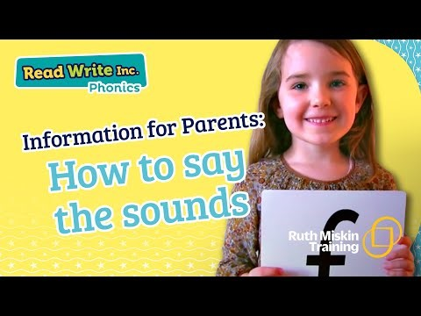
How can parents help at home?
Practising the red and green words at home from the book they are reading that week.
Encouraging their child to say the letter sounds correctly when they fred talk words for reading and spelling.
Supporting their child in spelling the red and green words sent home each week.
Reading with their child regularly including their school phonics reader, reading for pleasure book and other stories and rhymes.

Slide 11
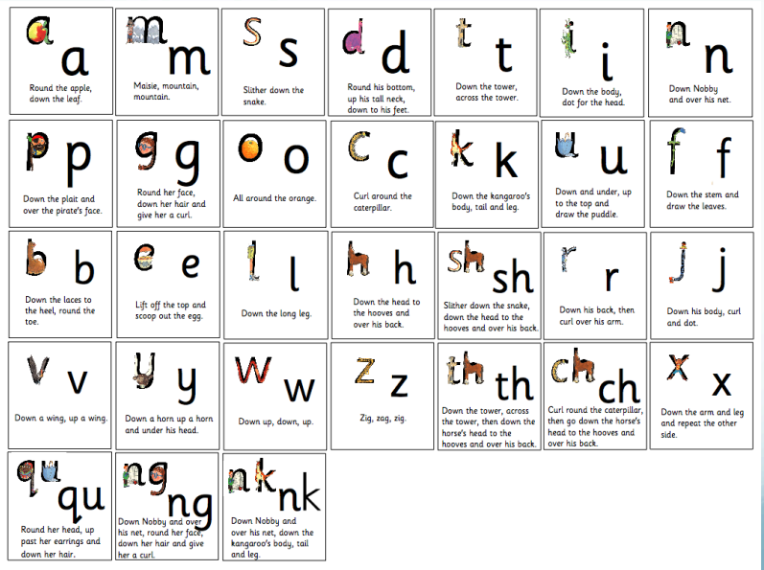
Set one sounds

Slide 12
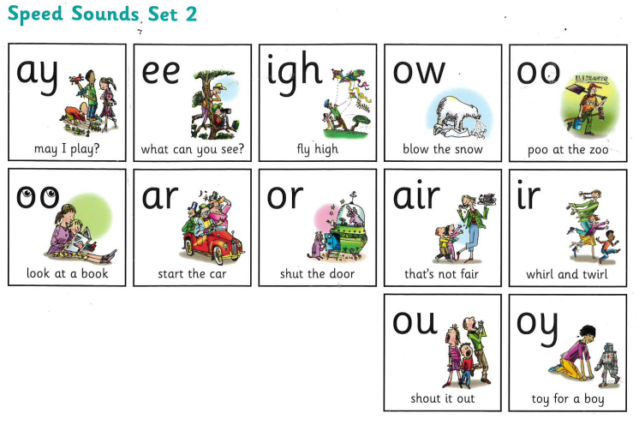
Set two sounds

Slide 13
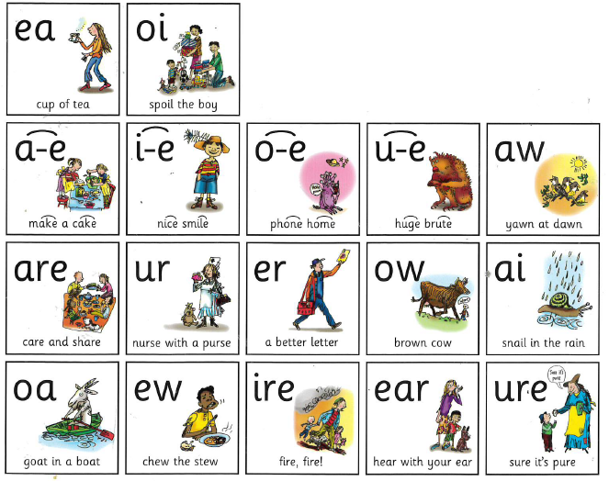
Set three sounds

